Slide 1
Personalized AI PET
졸업작품2
2분반 6조
202033312 Kim Yeji
202139848 Kang Minjae
202135771 Park Jonghyun
202135744 Kim Uijin
202135826 Jang Heejin

Slide 2
Contents
01
Introduction
02
Implementation
03
Demo
04
Improvement Opportunities
Notes:
프로젝트 소개
구현
데모
개선과제

Slide 3
01
Introduction
Background and Motivation
Objectives and Unique Features of AI PET

Slide 4
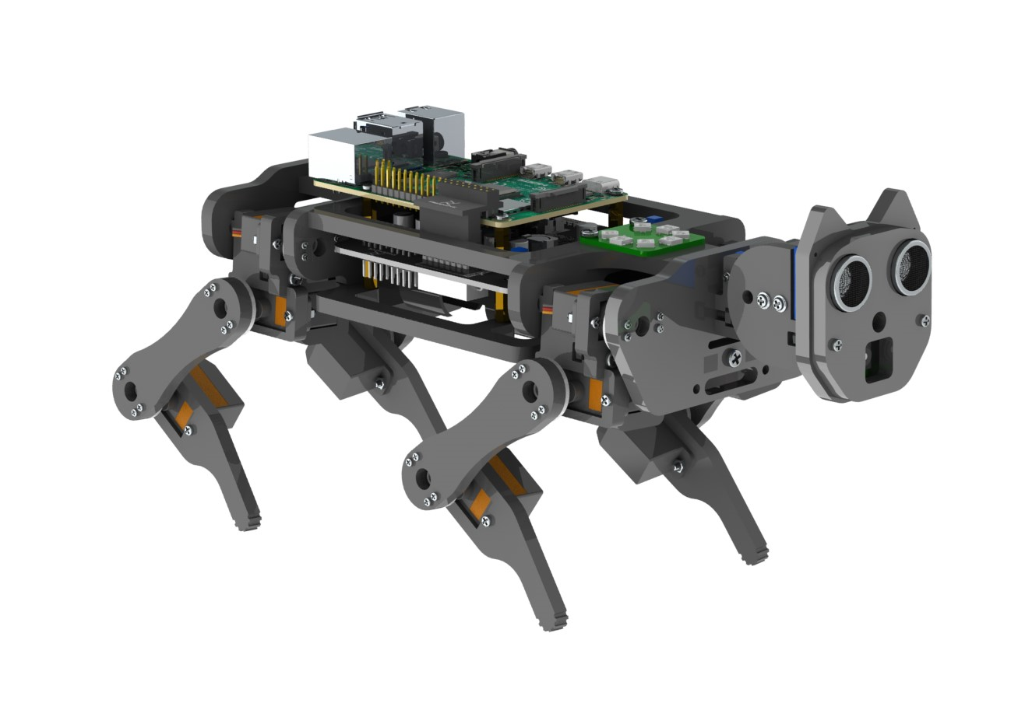
1. Introduction
Motivation
Post-COVID Depression Rise: Identifying a need for emotional support.
Real Pets' Limitations: High cost and care challenges.
Our AI Pet Solution: Using “Freenove” for a cost-effective, interactive pet alternative.
<Freenove Raspberry Pi>
Notes:
코로나 이후 우울증 증가: 감정적 지원의 필요성 인식.
실제 애완동물의 한계: 높은 비용과 관리 어려움.
우리의 AI Pet 솔루션: Freenove 기술을 사용한 비용 효율적이고 상호 작용이 풍부한 애완동물 대안.

Slide 5



1. Introduction
Our Goals
Text
Text
Text
Enhanced
Emotion Recognition
More
Natural Interaction
Personalized behavior system

Slide 6
02
Implementation
System Architecture Overview
Integration and Data Flow
Development Process

Slide 7
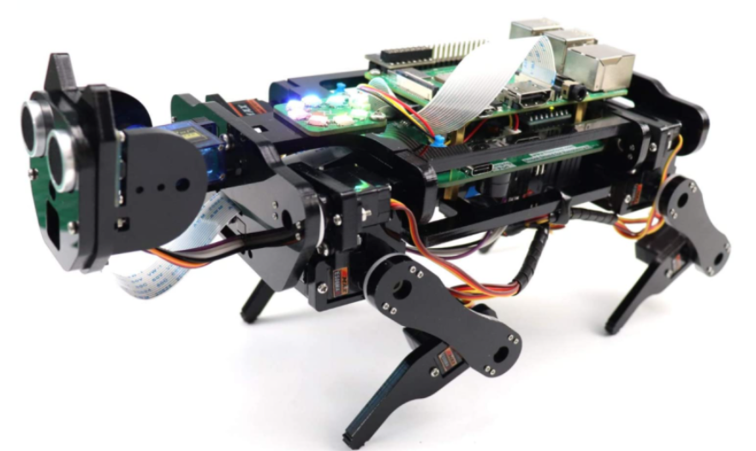
2. Overall Architecture
System Overview
Emotion
(faces)
5 emotions
Send frame
Input
Images
*Update Weights
Reinforcement Learning
Reward
(hand signs)
Positive(+)
Negative(-)
Behavior
Recommended Model
Raspberry
Instructions
Behavior Vector
action

Slide 8
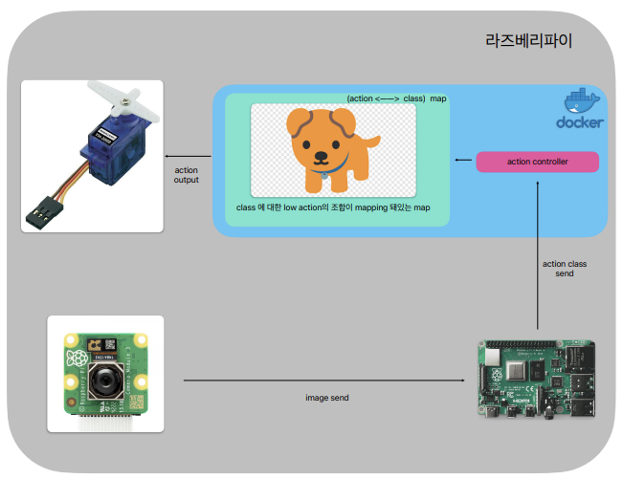
3. Implementation - Device
Data Flow in Device
Device and Server Interaction
Unfiltered Frame Transmission: Device sends all captured frames to the server indiscriminately.
Action Execution: Device performs 'high action' matched with the server's command.
High Action Range: Approximately 5-10 actions predefined (-1 received for 'no command').

Slide 9
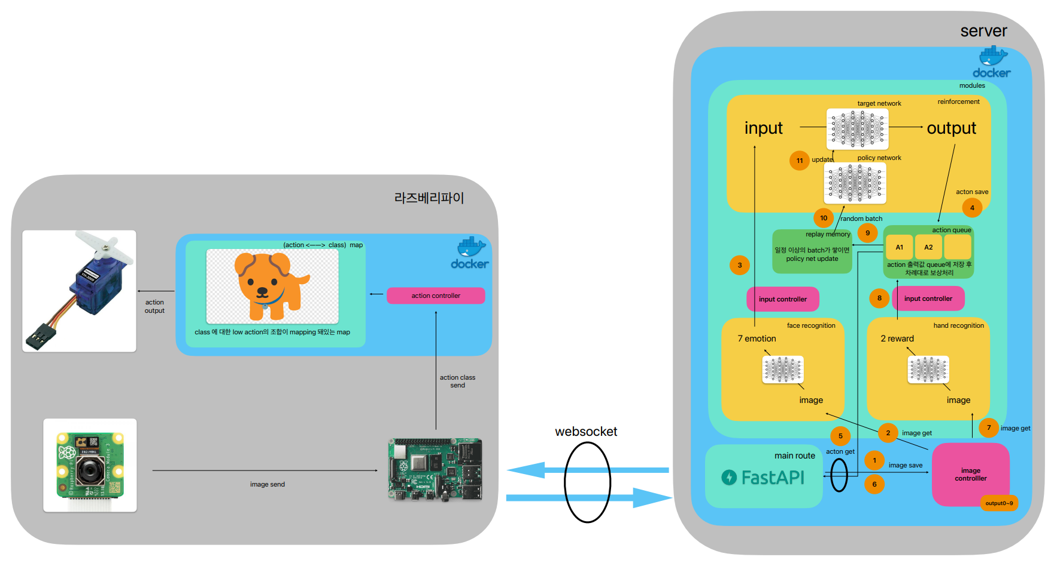
3. Implementation - Server
4
Data Flow in Server
5
2
3
1

Slide 10
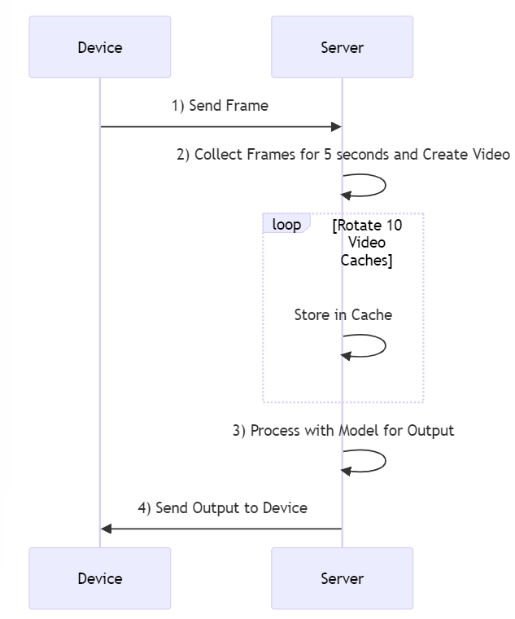
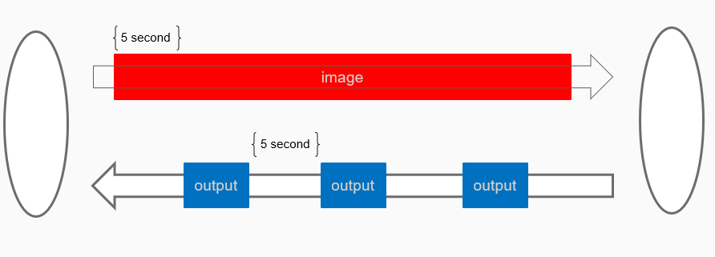
3. Implementation - Server
1.Communication(using WebSocket) Socket

Slide 11
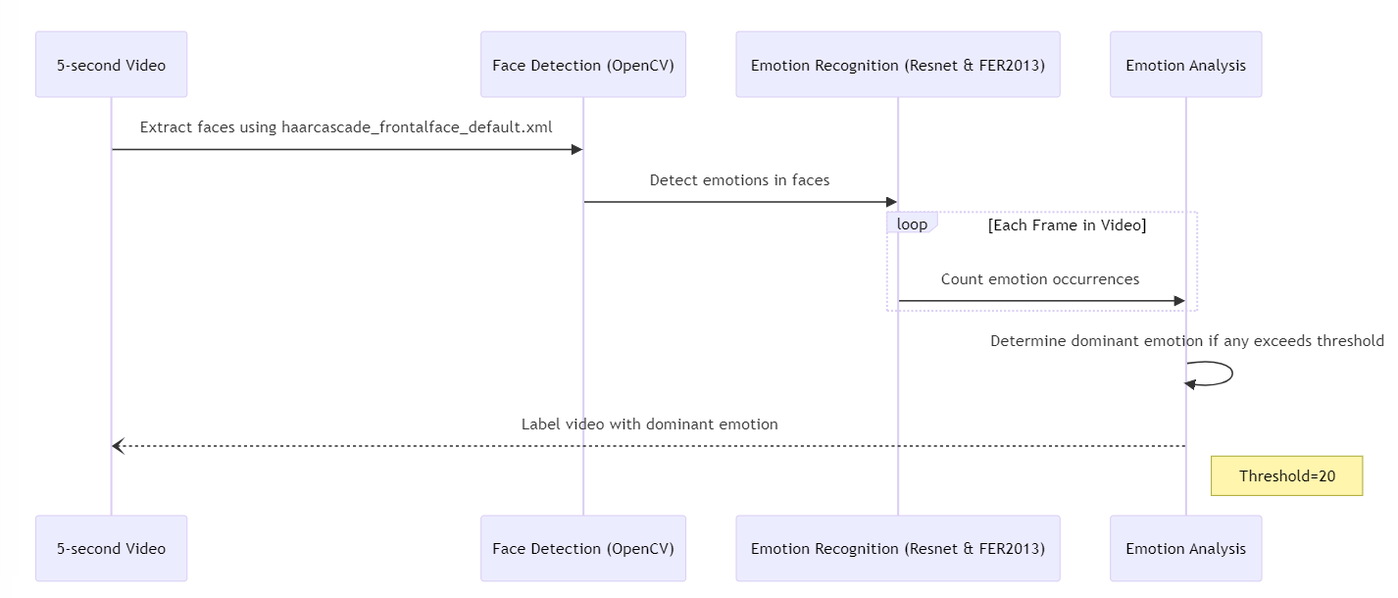
3. Implementation - Server
2. Face Recognition
reference : https://github.com/Conero007/Emotion-Detection-Pytorch.git
1.
2.
3.

Slide 12
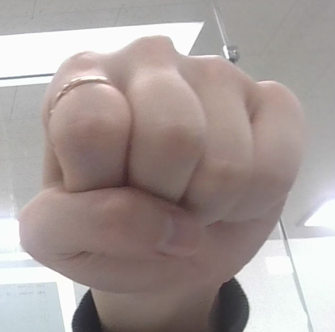
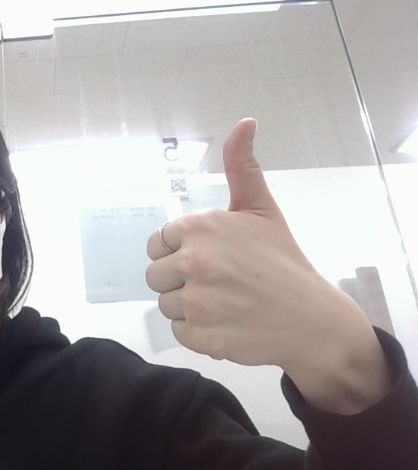
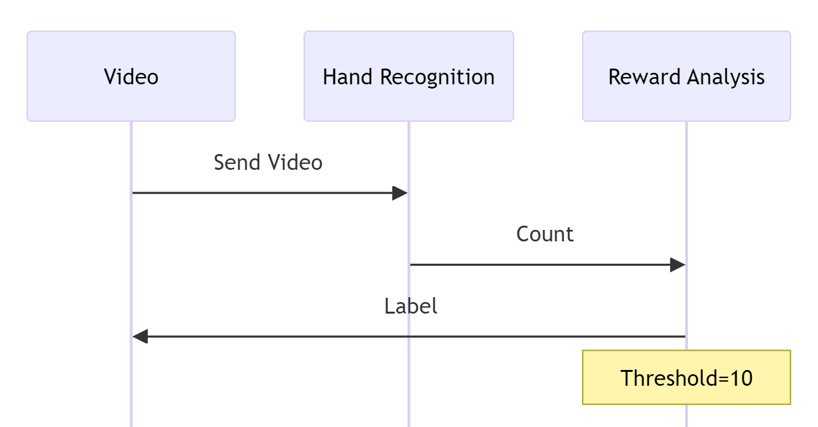

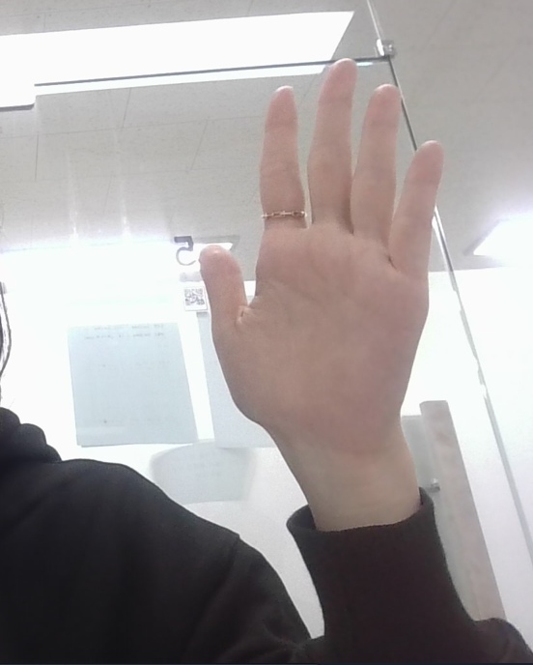
3. Implementation - Server
3. Hand Recognition
Train Process
Nothing
Positive
Inference
1. Image
Negative
Stop
2. Label Actions
(Positive, Nothing, Negative, Stop)
Frame Recognition
3. Train (YOLOv5)
Training Parameters:
Epochs: 50
Batch Size: 16
Image : 240

Slide 13
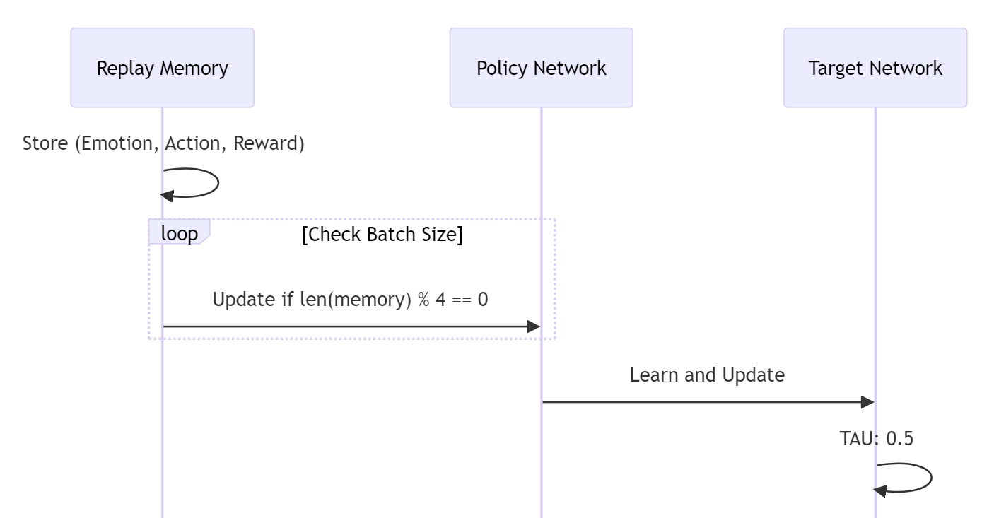
3. Implementation - Server
4. Reinforcement Learning
Deep Q-Network(DQN) for learning
2 techniques in DQN Paper for learning efficiency:
1. Replay Memory
2. Target Network & Policy Network
Hasselt, H. van, Guez, A., & Silver, D. (2016). Deep Reinforcement Learning with Double Q-Learning.

Slide 14
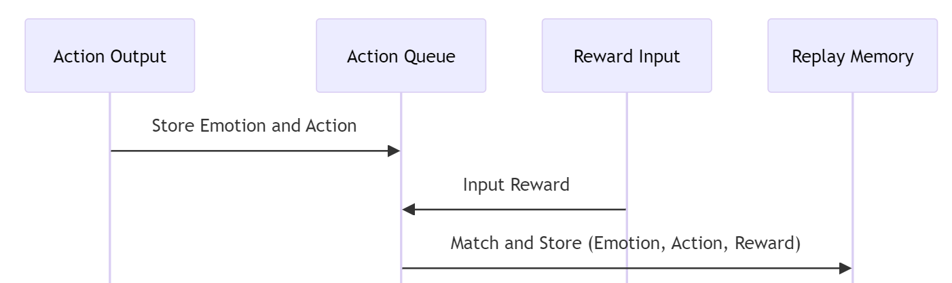
3. Implementation - Server
5. Data Synchronization
Problem: Emotion and action inputs have short intervals; rewards are delayed and irregular.
Goal: Synchronize (emotion, action, reward) tuple for reinforcement learning.
Action Queue Mechanism: Temporarily stores (emotion, action) pairs.
Matching Process: Later matches rewards with stored pairs when received.

Slide 15
03
Demo
Demo video

Slide 16
4. Demo
https://youtu.be/GDskCXtEZZY

Slide 17
04
Improvement Opportunities
AS-IS, TO-BE

Slide 18
5. Future work
AS-IS
TO-BE
Pattern Learning: Increase in predefined patterns and actions.
Action Queue Management: Implement timeouts, enhance recognition threshold, and accuracy.
Field of View: Introduce actions for broader visibility or autonomous roaming.
Parameter Tuning: Refine model parameters for better performance.
Frame Limitation: Restrict the number of frames sent via websocket.
Cycle Time Adjustment: Extend cycle times and utilize asynchronous processing for actions.
Cold Start: Initial system startup challenges.
Matching Algorithm: Inconsistencies in action-reward pairing.
Exploration Algorithm: Lack of direction when no command is received.
Parameter Tuning: Difficulty in adjusting model parameters for optimal performance.
Server Traffic: Handling high volumes of server requests.
Action Stability: Instability with actions that exceed the cycle time.

Slide 19
Thank you
Thank you for listening to my presentation

